Slide 1
Markov Decision processes
Session 18
Henry Lucky, S.Kom., M.Kom.

Slide 2
Learning Outcomes
Session 18
At the end of this session, students will be able to:
LO 4: Apply various techniques to an agent when acting under certainty

Slide 3
outline
Session 18
Markov Decision Processes
Utility
The discount factor
Value Iteration
Policy Iteration
Comparison of value and policy iteration

Slide 4
Markov Decision Processes
Intelligent agent actions
How does an intelligent agent plan its actions?
  If there is no randomness: Use A* search to plan the best path
  What if our movements are affected by randomness?

Slide 5
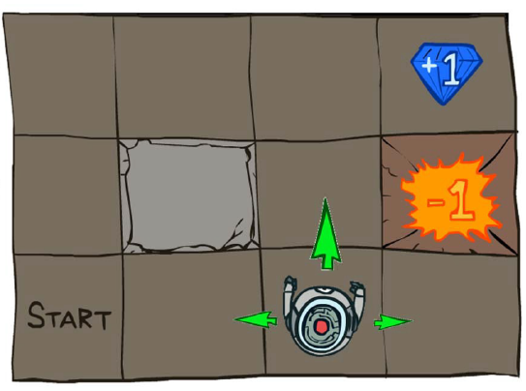
Markov Decision Processes
Example: Grid world
Maze solving problem: state is s=(I, j), where 0<=i<=2 is the row and 0<=j<=3 is the column.
The robot is trying to find its way to the diamond
If it reaches the diamond, it gets a reward of r((0,3))= +1 and the game ends
If it falls in the fire, it gets a reward of r((1, 3)) = -1 and the game ends.

Slide 6
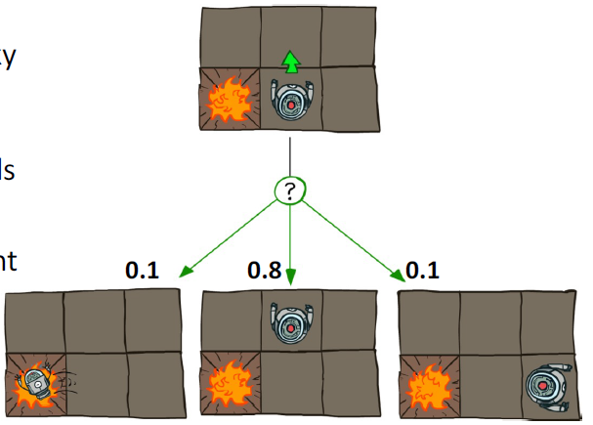
Markov Decision Processes
Example: Grid world
Randomness: the robot has shaky actuators. If it tries to move forward,
  With probability 0.8, it succeeds.
  With probability 0.1, it falls left.
  With probability 0.1, it falls right.

Slide 7
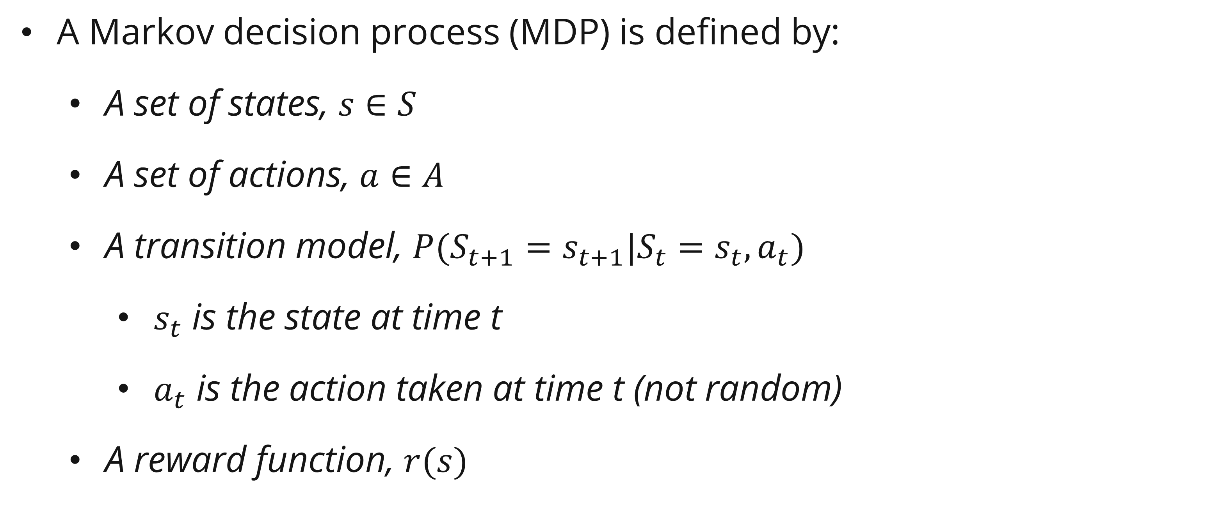
Markov Decision Processes
Definition
A Markov decision process (MDP) is defined by:
  A set of states, $s∈S$
  A set of actions, $a∈A$
  A transition model, $P(S_{t+1}=s_{t+1}|S_{t}=s_{t}, a_{t})$
    $s_{t}$ is the state at time t
    $a_{t}$ is the action taken at time t (not random)
  A reward function, $r(s)$

Slide 8
Markov Decision Processes
Solving an MDP: the policy
The solution to a maze is a path: the shortest path from start to goal
In MDP, finding 1 path is not enough: randomness might cause us to accidentally deviate from optimal path.

Slide 9

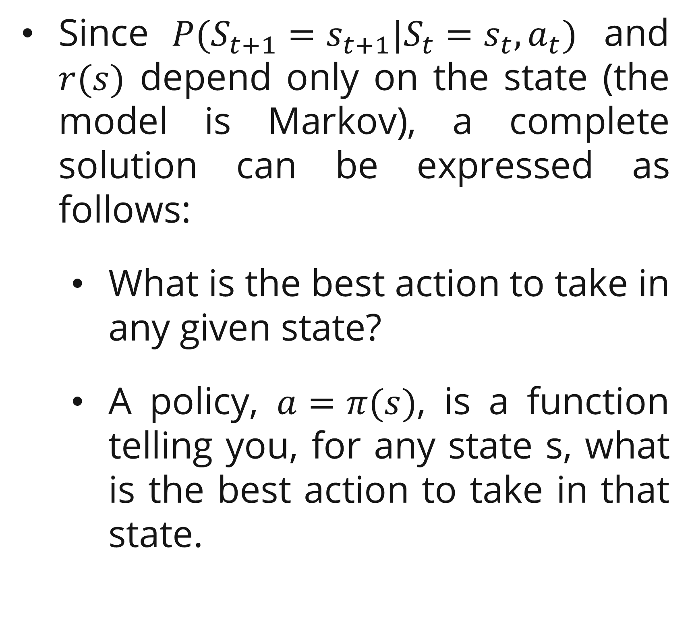
Markov Decision Processes
Solving an MDP: the policy
Since $P(S_{t+1}=s_{t+1}|S_{t}=s_{t}, a_{t})$ and $r(s)$ depend only on the state (the model is Markov), a complete solution can be expressed as follows:
  What is the best action to take in any given state?
  A policy, $a=π(s)$, is a function telling you, for any state s, what is the best action to take in that state.

Slide 10
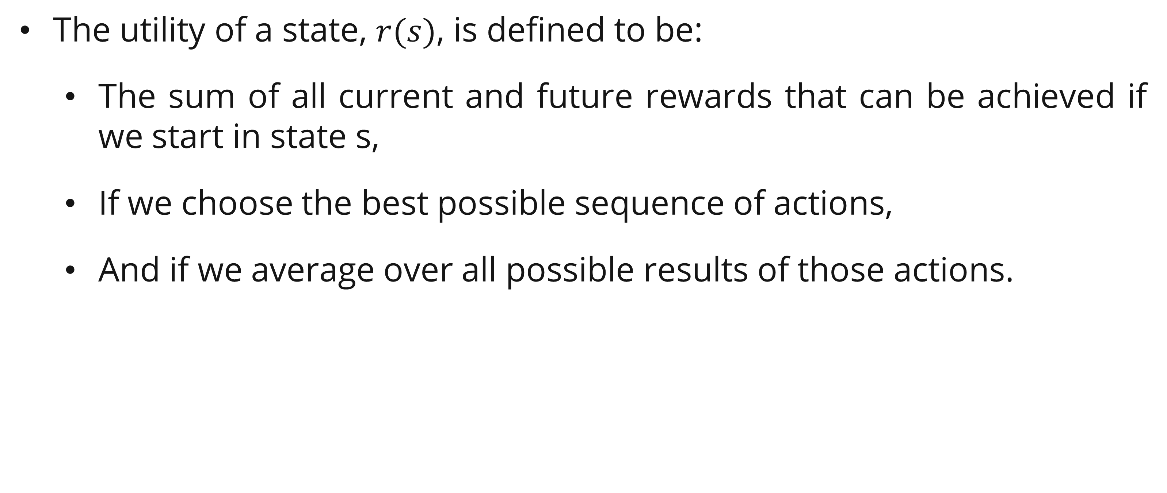
Utility
Definition
The utility of a state, $r(s)$, is defined to be:
  The sum of all current and future rewards that can be achieved if we start in state s,
  If we choose the best possible sequence of actions,
  And if we average over all possible results of those actions.

Slide 11
Utility
Example: game show
You’ve been offered a spot as a contestant in a game show.
  Reward: you receive successively larger prizes for each question you answer correctly, but if you answer any question incorrectly, you lose it all.
  Transition: the questions become harder and harder to answer.
  Actions: after each question, you can decide whether to take another question, or stop.

Slide 12
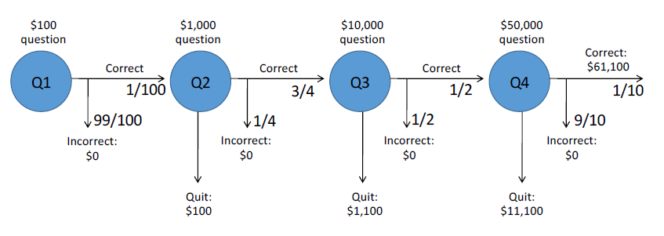
Utility
Example: game show
Policy:
  If you have correctly answered N-1 questions, should you attempt question QN or stop?

Slide 13

Utility
Example: game show
Policy $π(Q4)$: If you have correctly answered 3 questions, should you attempt questions Q4 or stop?
If you stop: total reward is $11,100
If you attempt Q4: expected total reward is 1/10 * 61100 + 9/10*0 = $6110
Policy: $π(Q4)$ = stop. Utility: $u\left(Q4\right)=\$11,100$

Slide 14

Utility
Example: game show
Policy $π(Q3)$: If you have correctly answered 2 questions, should you attempt questions Q3 or stop?
If you stop: total reward is $1,100
If you attempt Q3: expected total reward is 1/2 * 11100 + 1/2*0 = $5550
Policy: $π(Q3)$ = continue. Utility: $u\left(Q3\right)=\$5550$

Slide 15

Utility
Example: game show
Policy $π(Q2)$: If you have correctly answered 1 questions, should you attempt questions Q2 or stop?
If you stop: total reward is $100
If you attempt Q2: expected total reward is 3/4 * 5550 + 1/4 * 0 = $4162.5
Policy: $π(Q2)$ = continue. Utility: $u\left(Q2\right)=\$4162.5$

Slide 16

Utility
Example: game show
Policy $π(Q1)$: If you have correctly answered no questions, then you have nothing to lose, so even though the success is very small, you might as well try it!
If you stop: total reward is $0
If you attempt Q1: expected total reward is 1/100 * 4162.5 + 99/100*0 = $41.63
Policy: $π(Q1)$ = continue. Utility: $u\left(Q1\right)=\$41.63$

Slide 17
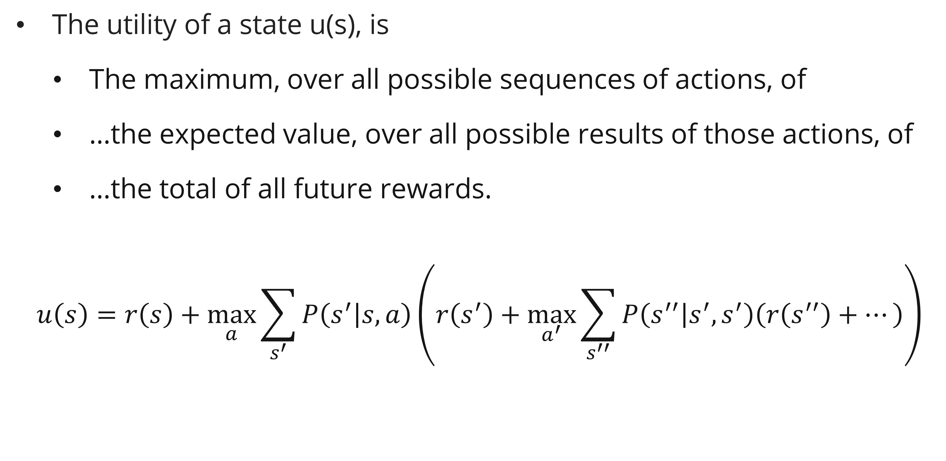
Utility
definition
The utility of a state u(s), is
  The maximum, over all possible sequences of actions, of
  …the expected value, over all possible results of those actions, of
  …the total of all future rewards.
$$u\left(s\right)=r\left(s\right)+\max_{a}{\sum_{s^{′}}{P\left(s^{′} | s,a\right)}}\left(r\left(s^{′}\right)+\max_{a^{′}}{\sum_{s^{′′}}{P\left(s^{′′} | s^{′},s^{′}\right)\left(r\left(s^{′′}\right)+…\right)}}\right)$$

Slide 18
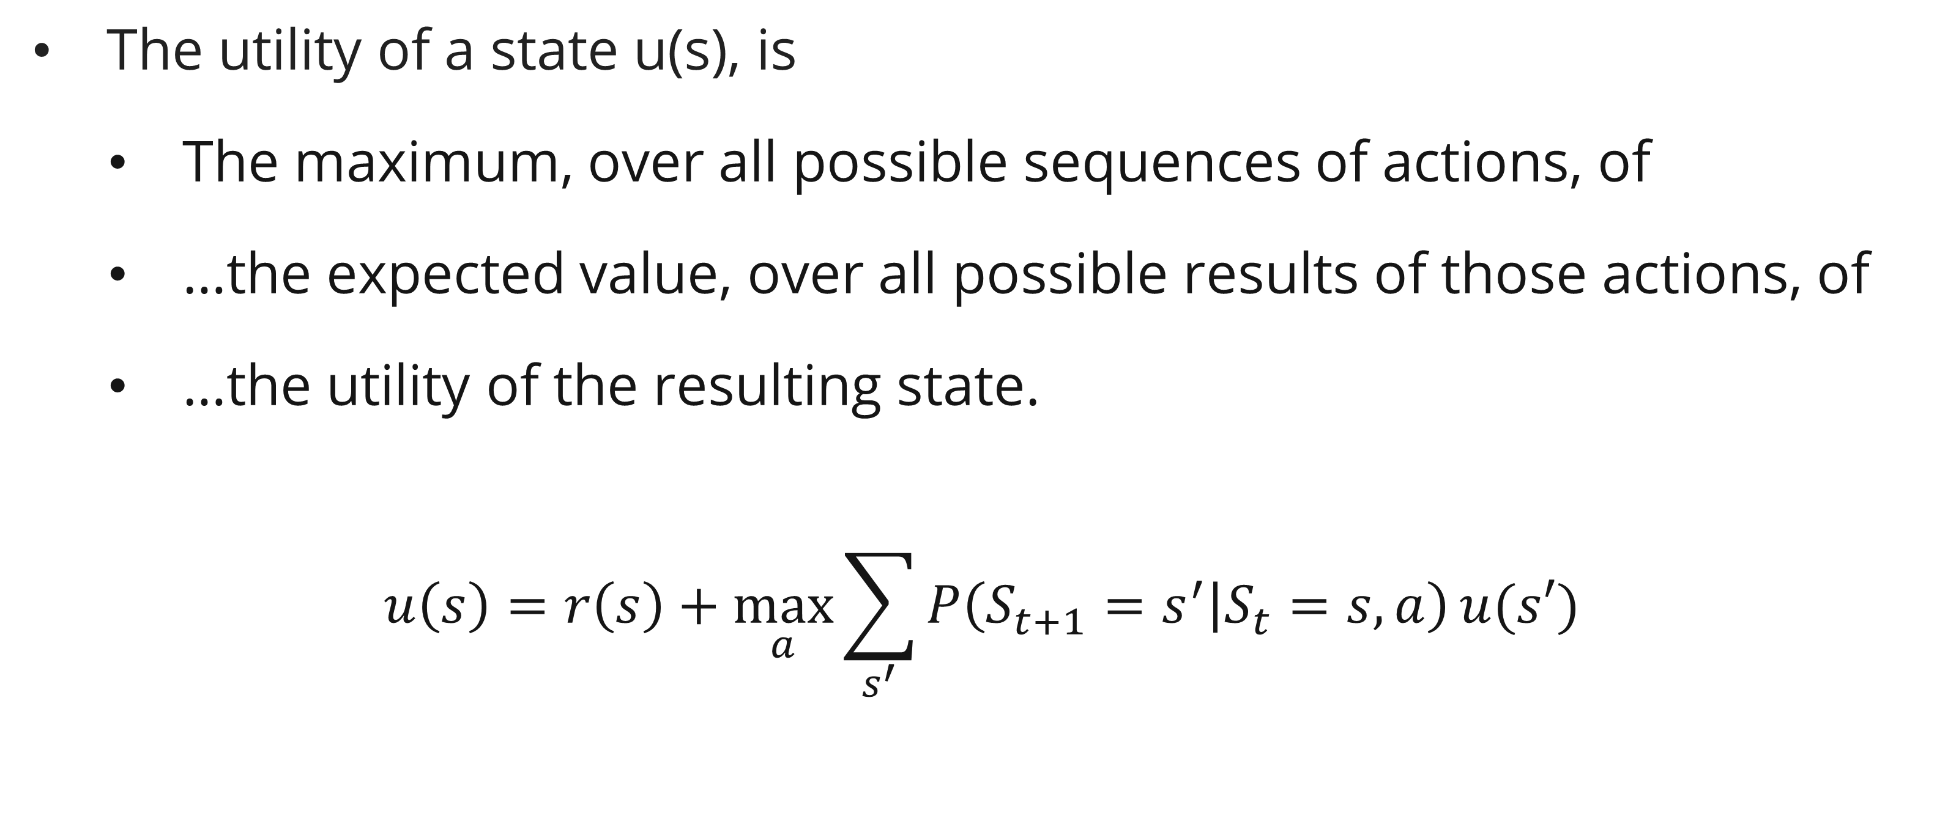
Utility
definition
The utility of a state u(s), is
  The maximum, over all possible sequences of actions, of
  …the expected value, over all possible results of those actions, of
  …the utility of the resulting state.
$$u\left(s\right)=r\left(s\right)+\max_{a}{\sum_{s^{′}}{P\left({S_{t+1}=s}^{′} | S_{t}=s,a\right)}}u(s′)$$

Slide 19
The discount factor
intro
You have just won a contest sponsored by the Galaxia Foundation.
They offer you the choice of two options:
$60,000 right now or…
$1000 per year, paid to you and your heirs annually forever.
Which option is better?

Slide 20
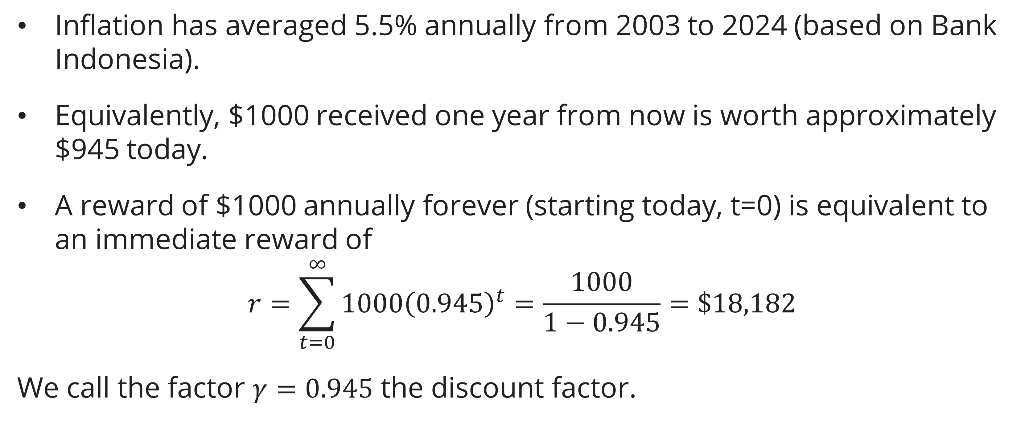
The discount factor
example
Inflation has averaged 5.5% annually from 2003 to 2024 (based on Bank Indonesia).
Equivalently, $1000 received one year from now is worth approximately $945 today.
A reward of $1000 annually forever (starting today, t=0) is equivalent to an immediate reward of
$$r=\sum_{t=0}^{∞}{1000{\left(0.945\right)}^{t}}=\frac{1000}{1−0.945}=\$18,182$$
We call the factor $γ=0.945$ the discount factor.

Slide 21
The discount factor
definition
Why is a dollar tomorrow worth less than a dollar today?
  A dollar will buy less tomorrow
  The person paying you might go out of business
  You might have to go into hiding and become unable to collect
The discount factor is our model of the unknowable uncertainty of promised future rewards

Slide 22
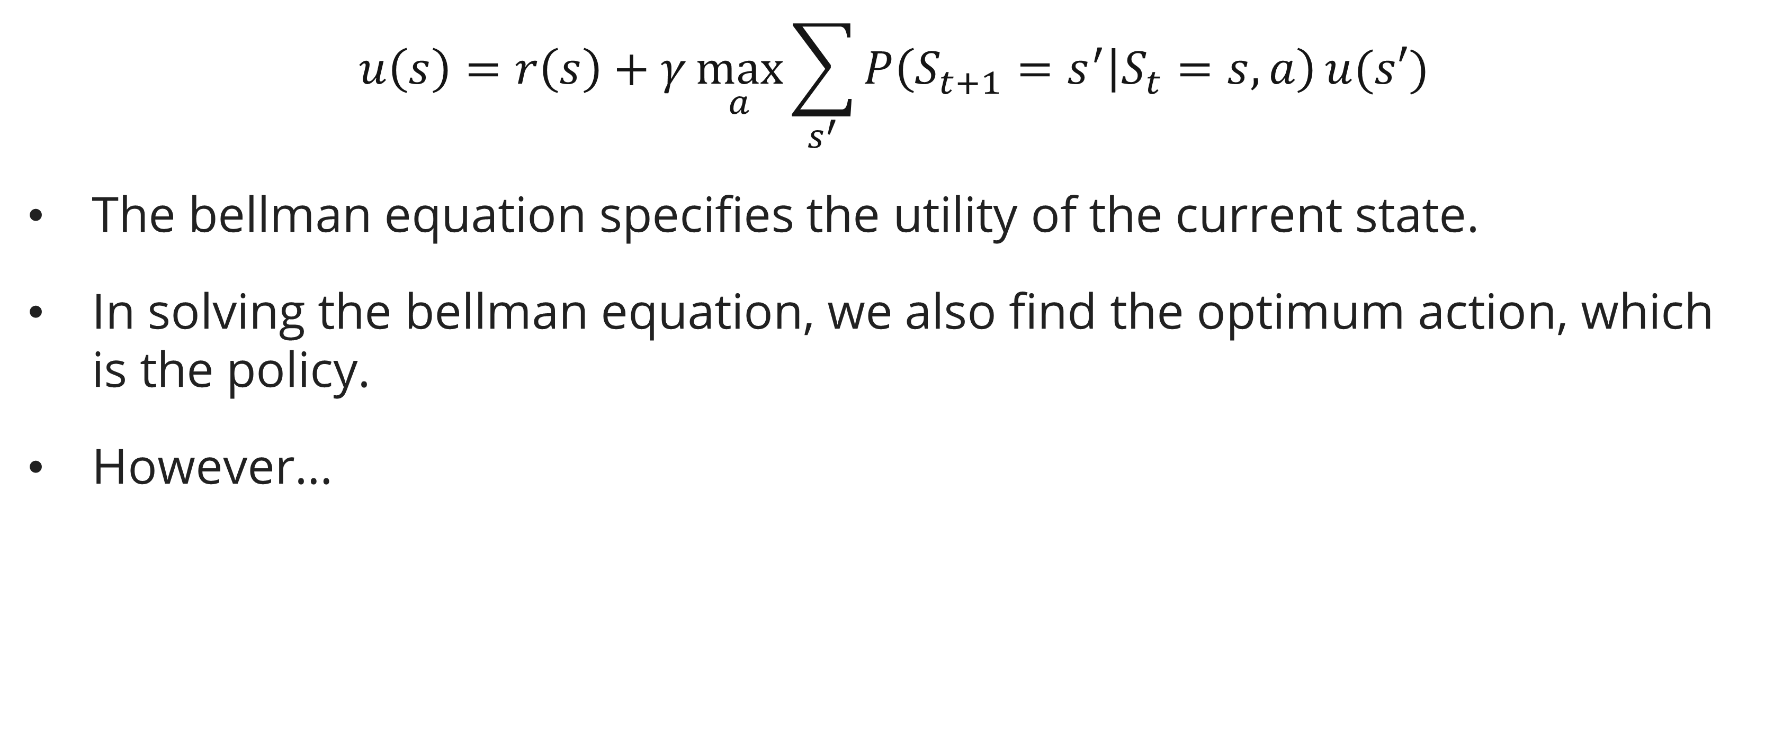
The discount factor
The bellman equation
$$u\left(s\right)=r\left(s\right)+γ\max_{a}{\sum_{s^{′}}{P\left({S_{t+1}=s}^{′} | S_{t}=s,a\right)}}u(s′)$$
The bellman equation specifies the utility of the current state.
In solving the bellman equation, we also find the optimum action, which is the policy.
However…

Slide 23
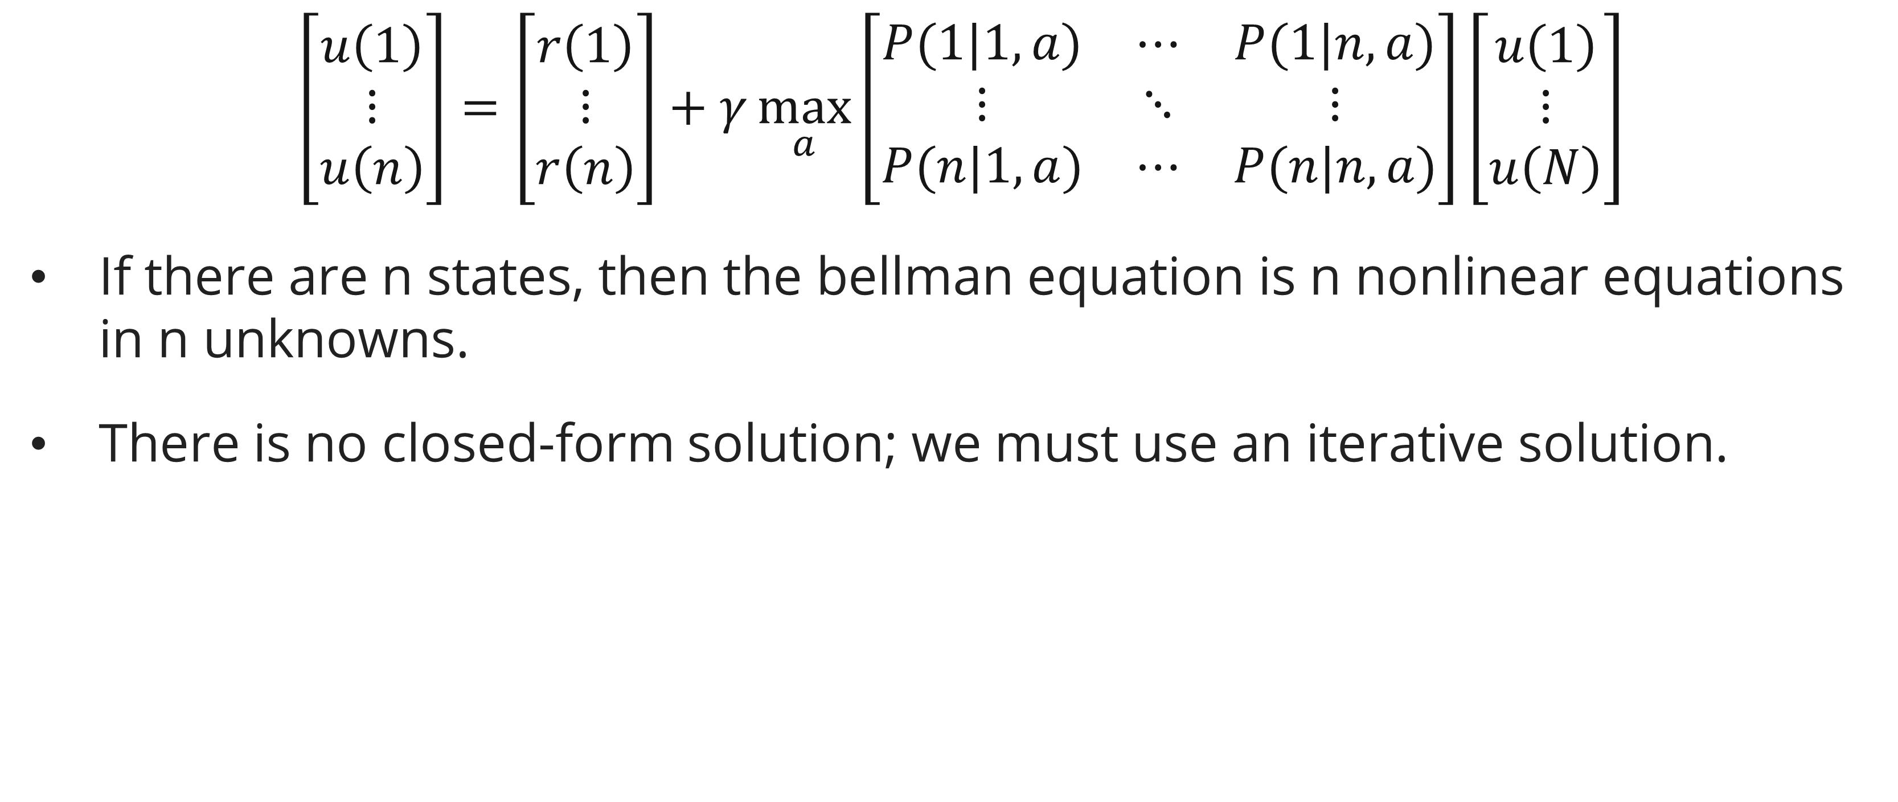
The discount factor
The bellman equation
$$\left[\begin{matrix}u\left(1\right) \\ ⋮ \\ u\left(n\right)\end{matrix}\right]=\left[\begin{matrix}r\left(1\right) \\ ⋮ \\ r\left(n\right)\end{matrix}\right]+γ\max_{a}\left[\begin{matrix}P(1|1,a) & ⋯ & P(1|n,a) \\ ⋮ & ⋱ & ⋮ \\ P(n|1,a) & ⋯ & P(n|n,a)\end{matrix}\right]\left[\begin{matrix}u\left(1\right) \\ ⋮ \\ u\left(N\right)\end{matrix}\right]$$
If there are n states, then the bellman equation is n nonlinear equations in n unknowns.
There is no closed-form solution; we must use an iterative solution.

Slide 24
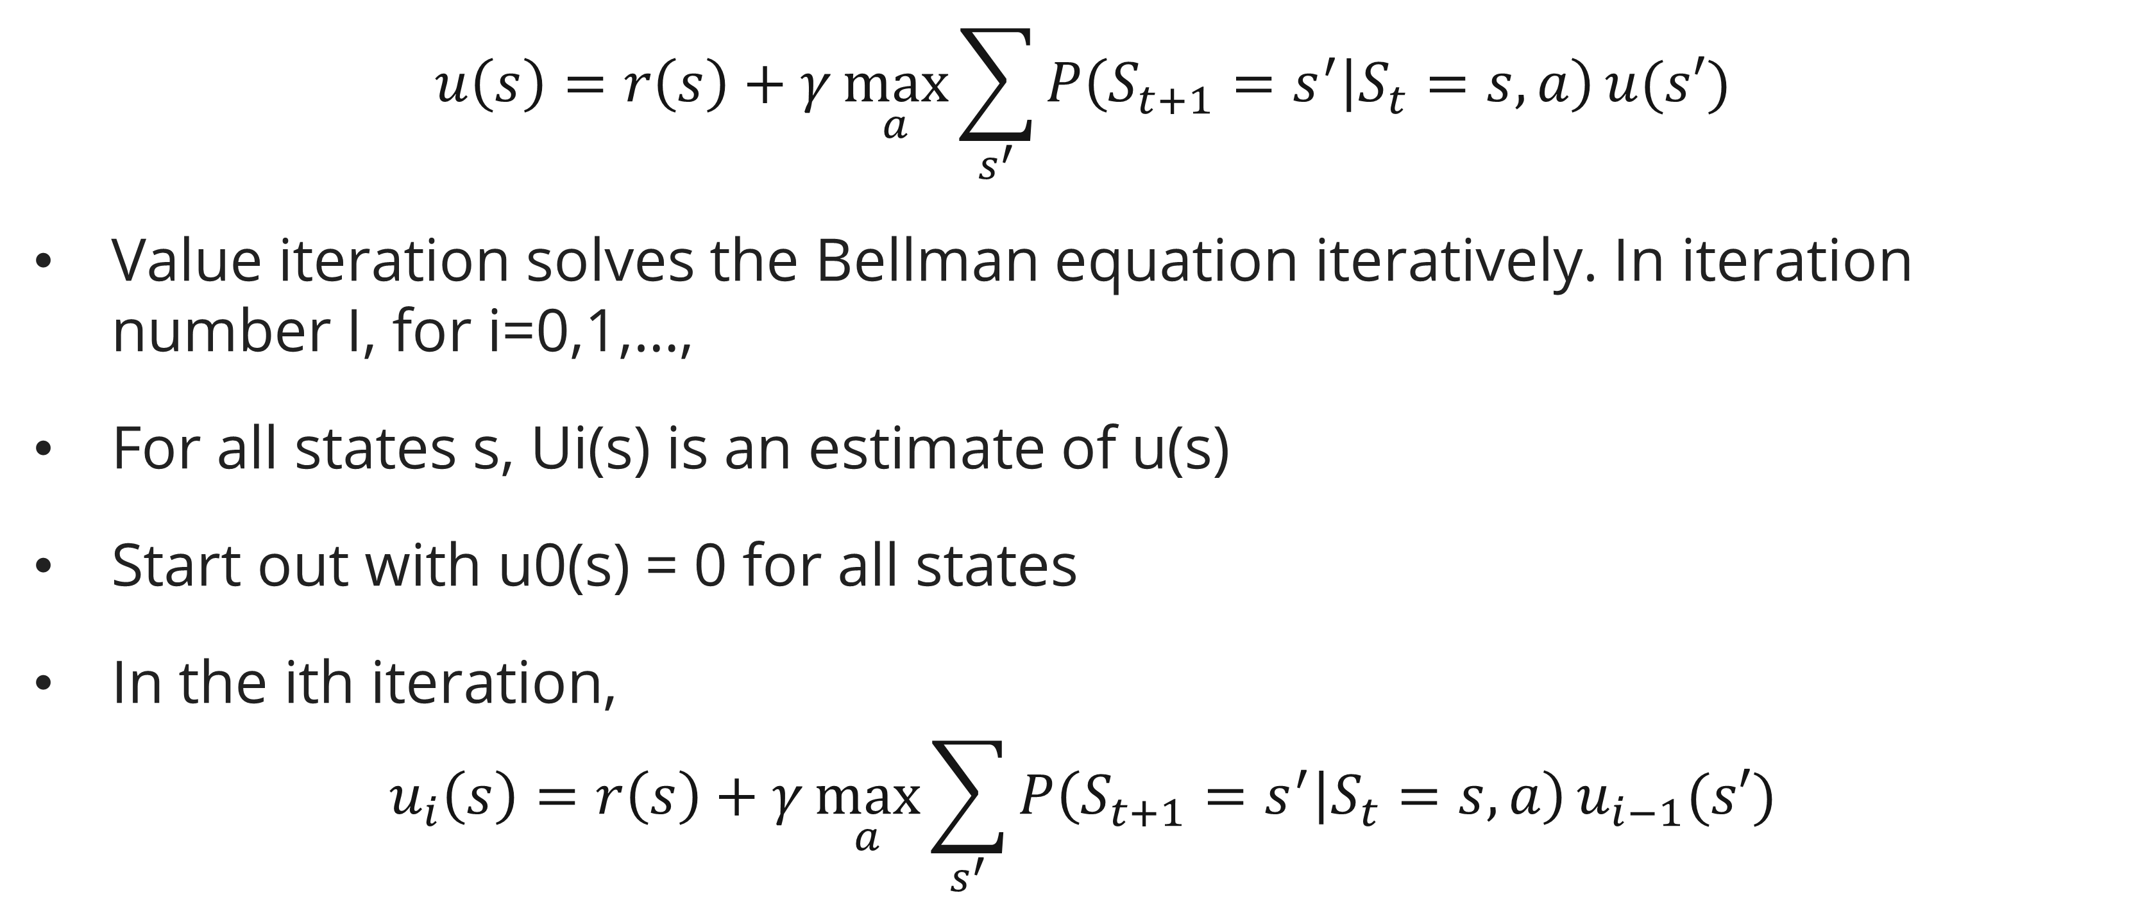
Value iteration
The bellman equation
$$u\left(s\right)=r\left(s\right)+γ\max_{a}{\sum_{s^{′}}{P\left({S_{t+1}=s}^{′} | S_{t}=s,a\right)}}u(s′)$$
Value iteration solves the Bellman equation iteratively. In iteration number I, for i=0,1,…,
For all states s, Ui(s) is an estimate of u(s)
Start out with u0(s) = 0 for all states
In the ith iteration,
$$u_{i}\left(s\right)=r\left(s\right)+γ\max_{a}{\sum_{s^{′}}{P\left({S_{t+1}=s}^{′} | S_{t}=s,a\right)}}u_{i−1}(s′)$$

Slide 25
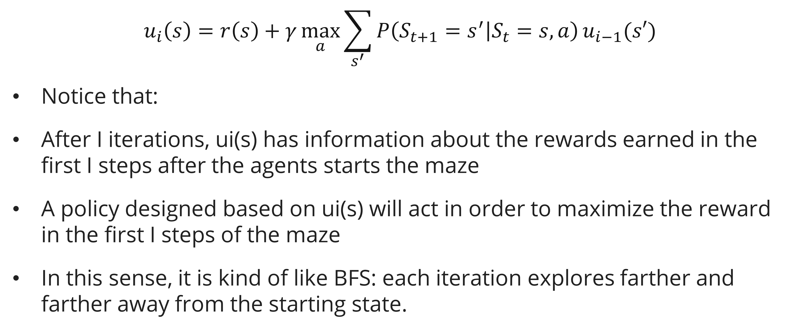
Value iteration
The bellman equation
$$u_{i}\left(s\right)=r\left(s\right)+γ\max_{a}{\sum_{s^{′}}{P\left({S_{t+1}=s}^{′} | S_{t}=s,a\right)}}u_{i−1}(s′)$$
Notice that:
After I iterations, ui(s) has information about the rewards earned in the first I steps after the agents starts the maze
A policy designed based on ui(s) will act in order to maximize the reward in the first I steps of the maze
In this sense, it is kind of like BFS: each iteration explores farther and farther away from the starting state.

Slide 26
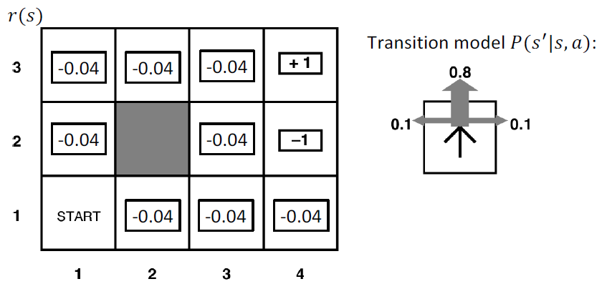
Value iteration
Example: the grid world
Assume a “loitering penalty” of r(s) = -0.04 for all non-terminal states.

Slide 27
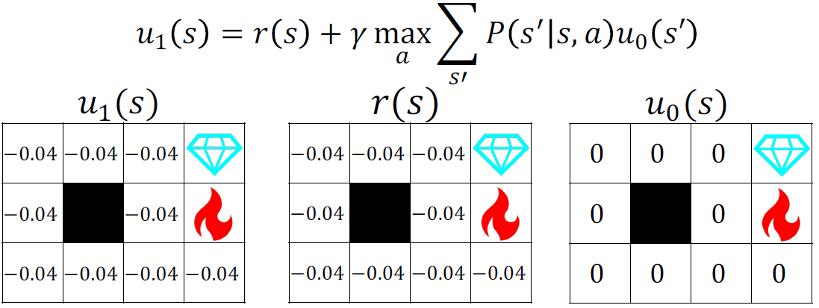
Value iteration
Example: the grid world
Value iteration: Iteration 1

Slide 28
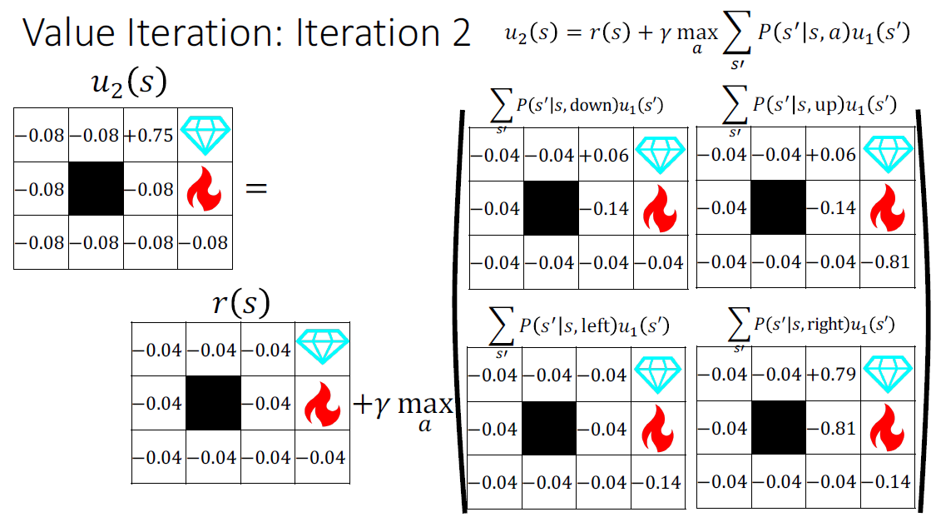
Value iteration
Example: the grid world
Value iteration: Iteration 2

Slide 29
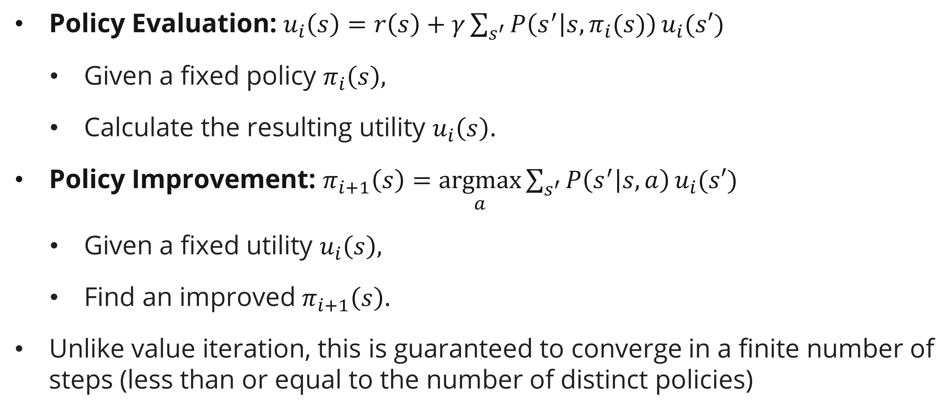
Policy iteration
definition
Policy Evaluation: $u_{i}\left(s\right)=r\left(s\right)+γ\sum_{s^{′}}{P\left(s^{′} | s,π_{i}(s)\right)}u_{i}(s′)$
  Given a fixed policy $π_{i}\left(s\right),$
  Calculate the resulting utility $u_{i}\left(s\right)$.
Policy Improvement: $π_{i+1}\left(s\right)=\underset{a}{argmax}{\sum_{s^{′}}{P\left(s^{′} | s,a\right)}}u_{i}(s′)$
  Given a fixed utility $u_{i}\left(s\right),$
  Find an improved $π_{i+1}\left(s\right)$.
Unlike value iteration, this is guaranteed to converge in a finite number of steps (less than or equal to the number of distinct policies)

Slide 30
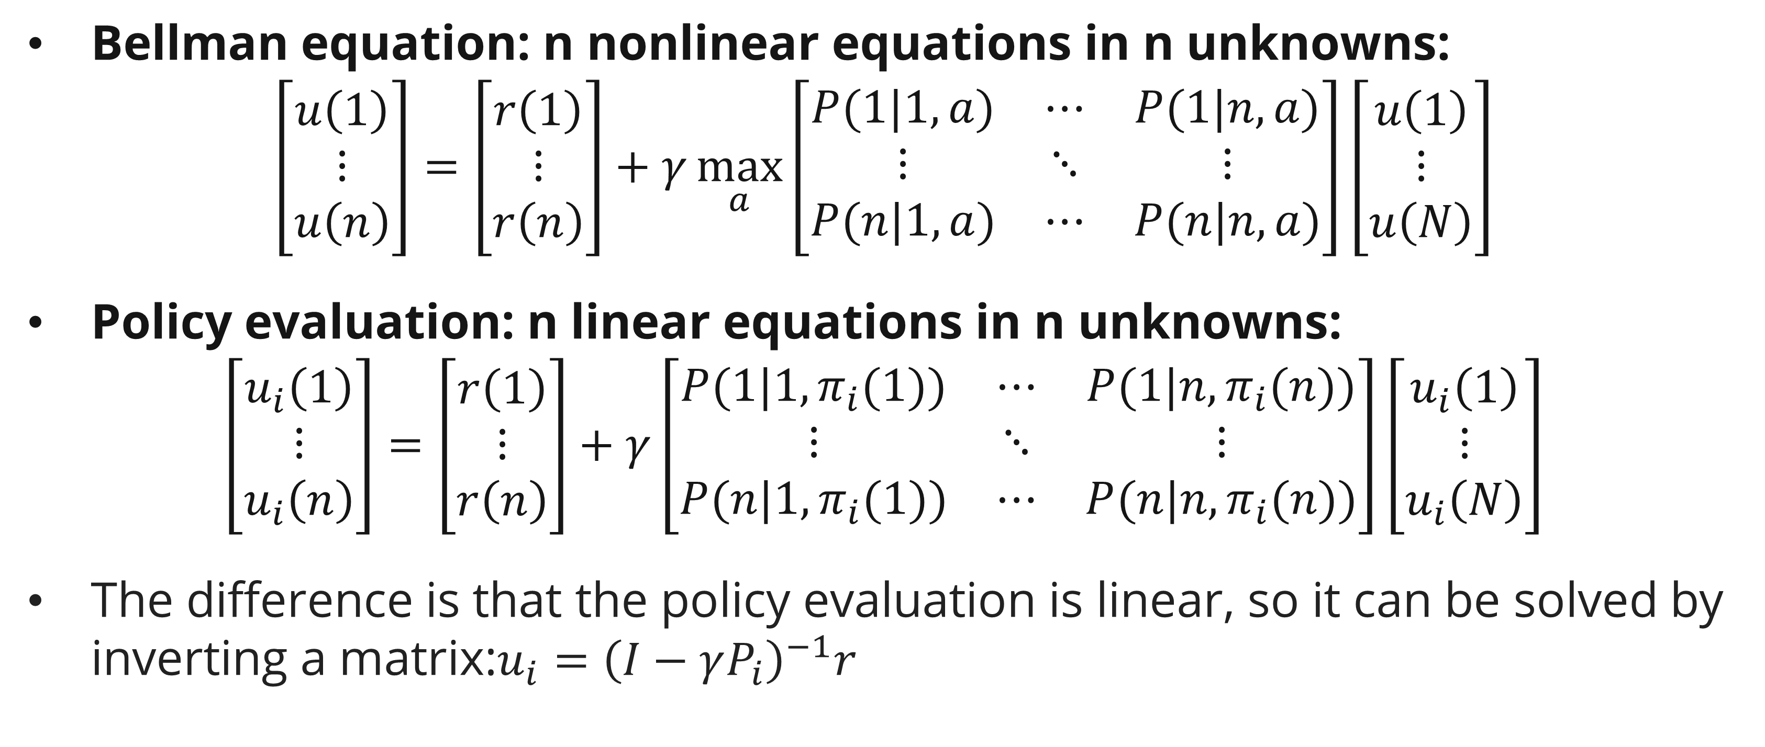
Policy iteration
definition
Bellman equation: n nonlinear equations in n unknowns:
$$\left[\begin{matrix}u\left(1\right) \\ ⋮ \\ u\left(n\right)\end{matrix}\right]=\left[\begin{matrix}r\left(1\right) \\ ⋮ \\ r\left(n\right)\end{matrix}\right]+γ\max_{a}\left[\begin{matrix}P(1|1,a) & ⋯ & P(1|n,a) \\ ⋮ & ⋱ & ⋮ \\ P(n|1,a) & ⋯ & P(n|n,a)\end{matrix}\right]\left[\begin{matrix}u\left(1\right) \\ ⋮ \\ u\left(N\right)\end{matrix}\right]$$
Policy evaluation: n linear equations in n unknowns:
$$\left[\begin{matrix}u_{i}\left(1\right) \\ ⋮ \\ u_{i}\left(n\right)\end{matrix}\right]=\left[\begin{matrix}r\left(1\right) \\ ⋮ \\ r\left(n\right)\end{matrix}\right]+γ\left[\begin{matrix}P(1|1,π_{i}(1)) & ⋯ & P(1|n,π_{i}(n)) \\ ⋮ & ⋱ & ⋮ \\ P(n|1,π_{i}(1)) & ⋯ & P(n|n,π_{i}(n))\end{matrix}\right]\left[\begin{matrix}u_{i}\left(1\right) \\ ⋮ \\ u_{i}\left(N\right)\end{matrix}\right]$$
The difference is that the policy evaluation is linear, so it can be solved by inverting a matrix:$u_{i}={\left(I−γP_{i}\right)}^{−1}r$

Slide 31
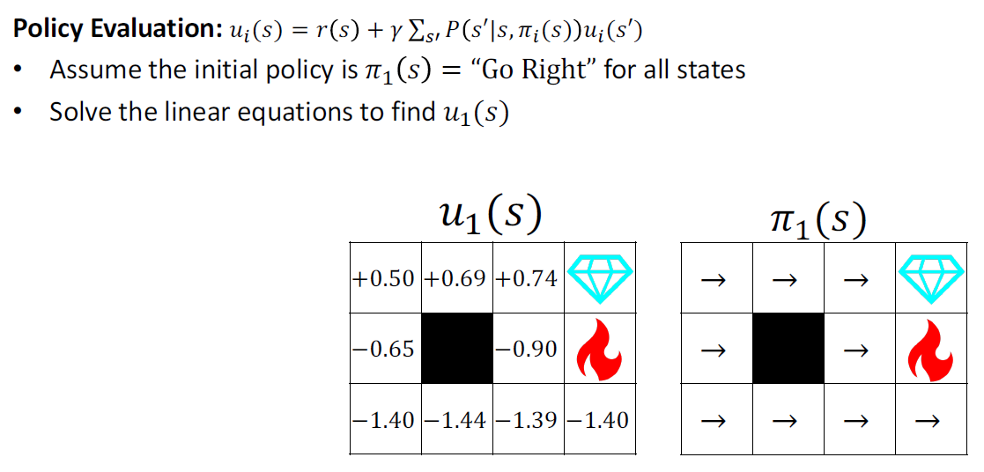
Policy iteration
Example grid world

Slide 32
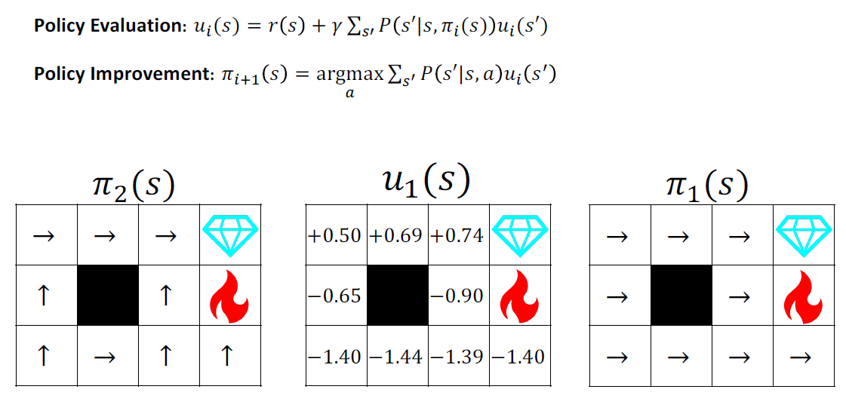
Policy iteration
Example grid world

Slide 33
References
Session 18
Peter Norvig, Stuart Russel. (2021). Artificial Intelligence: A Modern Approach. Pearson. London. ISBN: 978-1292401133. Ch. 19-20.
CS440 Artificial Intelligence, Mark Hasegawa-Johnson

